Slide 1

Who am I?
????

Slide 3

Entrepreneur’s and their Characteristics!

Slide 4
2:00
1:59
1:58
1:57
1:56
1:55
1:54
1:53
1:52
1:51
1:50
1:49
1:48
1:47
1:46
1:45
1:44
1:43
1:42
1:41
1:40
1:39
1:38
1:37
1:36
1:35
1:34
1:33
1:32
1:31
1:30
1:29
1:28
1:27
1:26
1:25
1:24
1:23
1:22
1:21
1:20
1:19
1:18
1:17
1:16
1:15
1:14
1:13
1:12
1:11
1:10
1:09
1:08
1:07
1:06
1:05
1:04
1:03
1:02
1:01
1:00
0:59
0:58
0:57
0:56
0:55
0:54
0:53
0:52
0:51
0:50
0:49
0:48
0:47
0:46
0:45
0:44
0:43
0:42
0:41
0:40
0:39
0:38
0:37
0:36
0:35
0:34
0:33
0:32
0:31
0:30
0:29
0:28
0:27
0:26
0:25
0:24
0:23
0:22
0:21
0:20
0:19
0:18
0:17
0:16
0:15
0:14
0:13
0:12
0:11
0:10
0:09
0:08
0:07
0:06
0:05
0:04
0:03
0:02
0:01
End
Title: Entrepreneurs and their Characteristics
Learning Intention: Understand that Entrepreneurs and their unique characteristics are important to businesses and their success
Success Criteria: Explain what the term entrepreneur means and provide examples of well-known entrepreneurs.

Slide 5
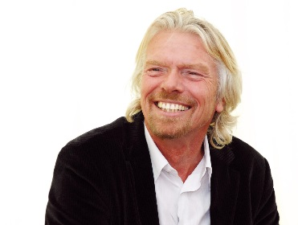
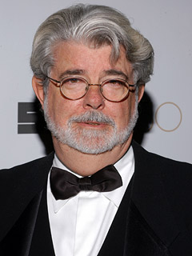
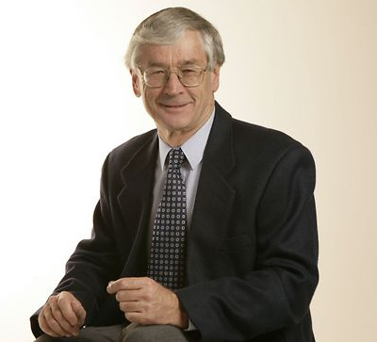
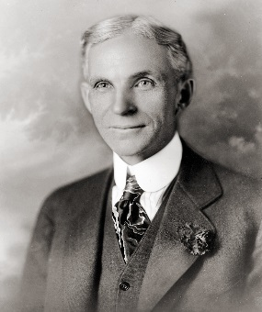
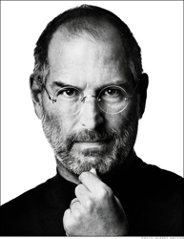
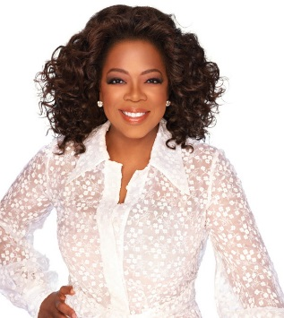
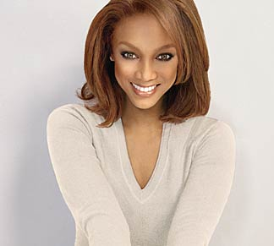
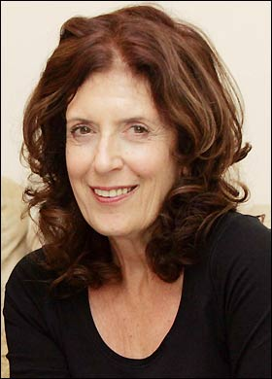
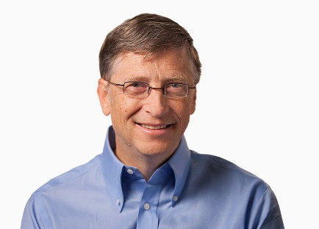
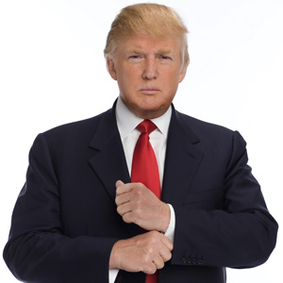
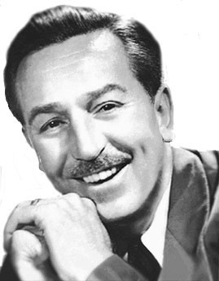
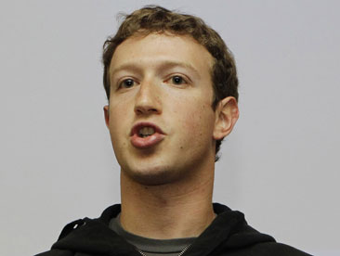
Do any of these people Look familiar?

Slide 6
What do they have in common?

Slide 7












1
2
3
4
5
6
7
8
9
10
11
12

Slide 8
Match the Entrepreneur with the logo/business they are known for!
2:00
1:59
1:58
1:57
1:56
1:55
1:54
1:53
1:52
1:51
1:50
1:49
1:48
1:47
1:46
1:45
1:44
1:43
1:42
1:41
1:40
1:39
1:38
1:37
1:36
1:35
1:34
1:33
1:32
1:31
1:30
1:29
1:28
1:27
1:26
1:25
1:24
1:23
1:22
1:21
1:20
1:19
1:18
1:17
1:16
1:15
1:14
1:13
1:12
1:11
1:10
1:09
1:08
1:07
1:06
1:05
1:04
1:03
1:02
1:01
1:00
0:59
0:58
0:57
0:56
0:55
0:54
0:53
0:52
0:51
0:50
0:49
0:48
0:47
0:46
0:45
0:44
0:43
0:42
0:41
0:40
0:39
0:38
0:37
0:36
0:35
0:34
0:33
0:32
0:31
0:30
0:29
0:28
0:27
0:26
0:25
0:24
0:23
0:22
0:21
0:20
0:19
0:18
0:17
0:16
0:15
0:14
0:13
0:12
0:11
0:10
0:09
0:08
0:07
0:06
0:05
0:04
0:03
0:02
0:01
End

Slide 9
1
2
3
4
5
6
7
8
9
10
11
12

Slide 10
What is an Entrepreneur?
“A person who organises, operates, and assumes the risk for a business venture”
“A person who takes the risk in starting a new business”
“A person who organises and manages any
enterprise, especially a business, usually with
considerable initiative and risk.”
(Dictionary.com, 2014)

Slide 11
What is an Entrepreneur?
Entrepreneur: an innovative person who sets out to build a successful business in a new field, often taking on risks to do so.

Slide 12
Key words…
Entrepreneur: an innovative person who sets out to build a successful business in a new field, often taking on risks to do so.
Innovative: A person can be described as innovative when the introduce new ideas, are original and creative thinkers.
Risk: a situation involving danger, harm or loss.

Slide 13
What characteristics do you think have led all of these Entrepreneurs to be successful?

Slide 14
Most successful entrepreneurs demonstrate a combination of these characteristics!
Innovation
Initiative
Self-motivation
Willingness to take on appropriate risks

Slide 15
Read the chapter and using the text make a note of a definition and example for each characteristic
Page 50 Pearson 7 Humanities and Social Sciences Textbook

Slide 16
Concluding questions…
What is the definition of an Entrepreneur?
What are the shared characteristics of entrepreneurs?
Which characteristics do you believe are the most important?
Which characteristics do you think you possess?
Who in the class do you think is most like an Entrepreneur?

Slide 17


Slide 18
Famous Failures!
https://www.youtube.com/watch?v=zLYECIjmnQs

Slide 19
References
Dictionary.com. 2014. Entrepreneur. Retrieved from http://dictionary.reference.com/browse/entrepreneur
Jones, P [ThisisPJTV]. (2008, January 8). Peter Jones’s ten rules for entrepreneurial success. [Video file]. Retrieved from http://www.youtube.com/watch?v=Tod1moy8VZM&feature=related
Image Credits:
http://andysacker.com/the-top-3-rules-on-becoming-a-rebel-entrepreneur/
http://carey.jhu.edu/one/2010/fall/the-mind-of-the-entrepreneur/

